Slide 1
Unsupervised Learning
Cluster Algorithm

Slide 2
What is unsupervised learning?
In the previous topic, we learned supervised machine learning in which models are trained using labeled data under the supervision of training data. But there may be many cases in which we do not have labeled data and need to find the hidden patterns from the given dataset. So, to solve such types of cases in machine learning, we need unsupervised learning techniques.

Slide 3
Unsupervised learning cannot be directly applied to a regression or classification problem because unlike supervised learning, we have the input data but no corresponding output data. The goal of unsupervised learning is to find the underlying structure of dataset, group that data according to similarities, and represent that dataset in a compressed format.

Slide 4
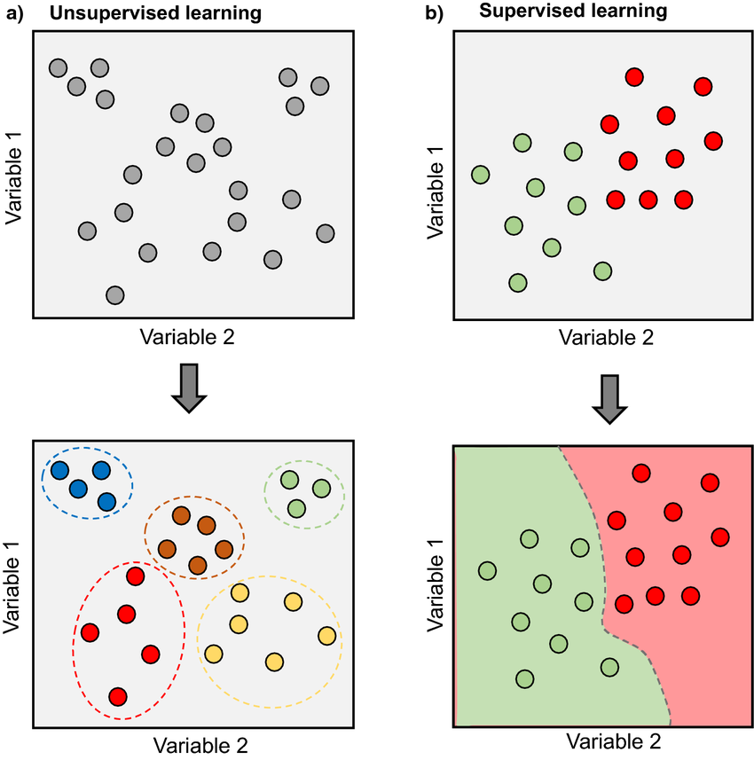

Slide 5
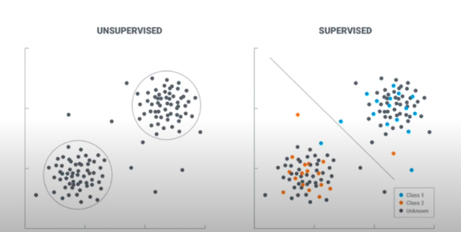

Slide 6
How does unsupervised learning work?
Unsupervised learning works by analyzing unlabeled data to identify patterns and relationships. The data is not labeled with any predefined categories or outcomes, so the algorithm must find these patterns and relationships on its own. This can be a challenging task, but it can also be very rewarding, as it can reveal insights into the data that would not be apparent from a labeled dataset.

Slide 7
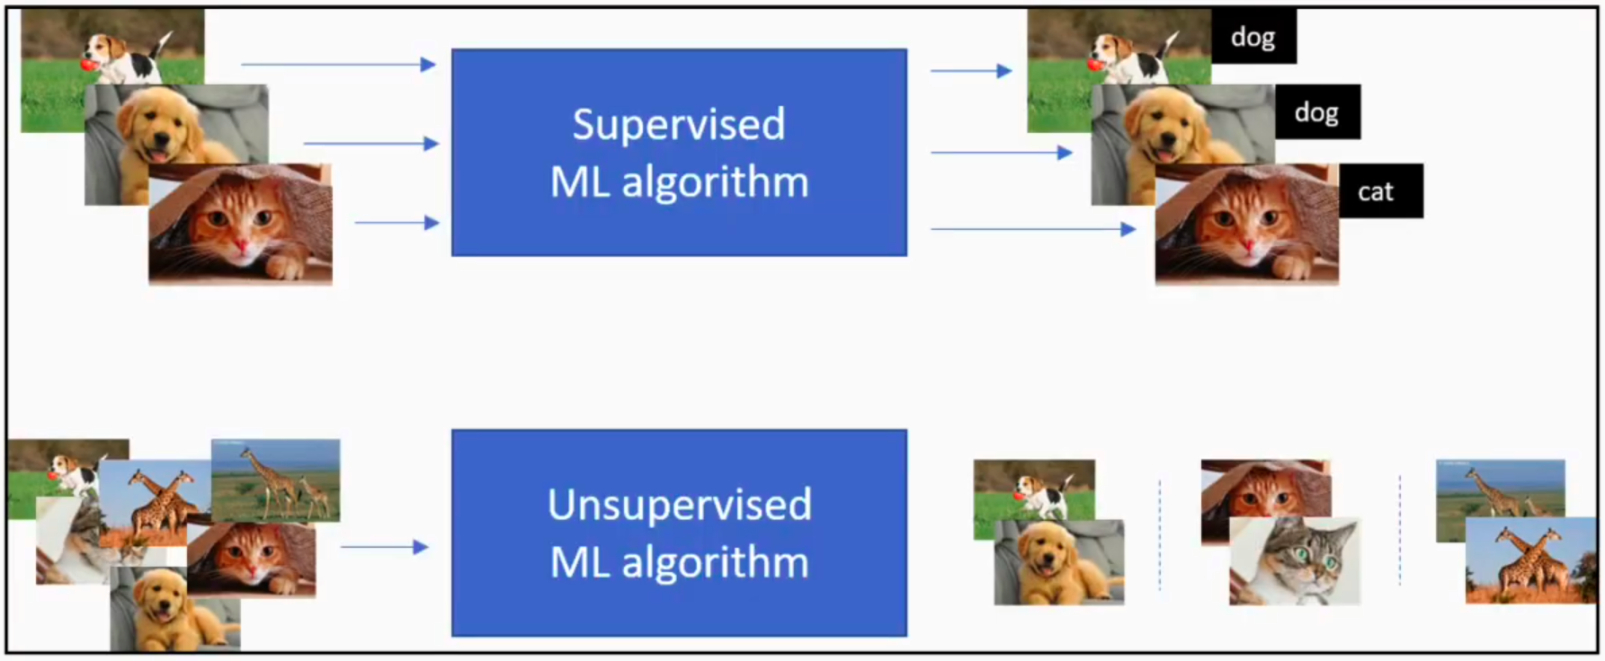

Slide 8
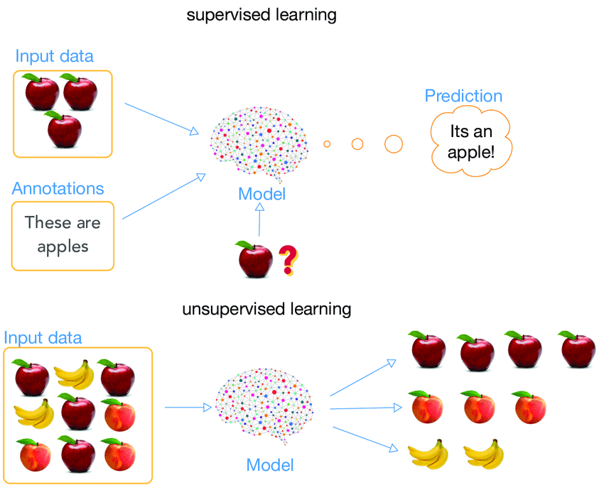

Slide 9
Types of Unsupervised Learning Algorithms
Clustering
Dimensionality Reduction

Slide 10
Clustering in Machine Learning
One of the most popular type of analysis under unsupervised learning is Cluster analysis. When the goal is to group similar data points in a dataset, then we use cluster analysis. In practical situations, we can use cluster analysis for customer segmentation for targeted advertisements, or in medical imaging to find unknown or new infected areas and many more use cases that we will discuss further in this article.

Slide 11
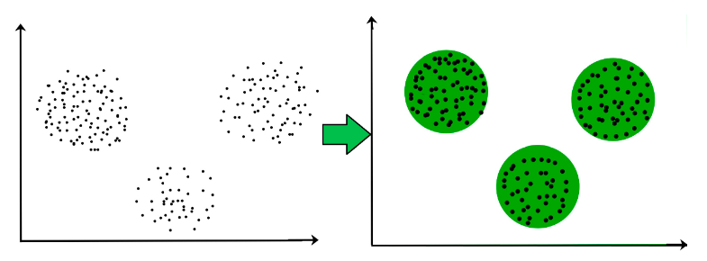

Slide 12
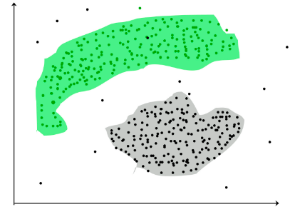

Slide 13
Types of clustering
Centroid-based clustering (K-Mean)
Density-based clustering
Distribution-based clustering
Hierarchical clustering

Slide 14
Centroid-based clustering (K-Mean)
K means clustering, assigns data points to one of the K clusters depending on their distance from the center of the clusters. It starts by randomly assigning the clusters centroid in the space. Then each data point assign to one of the cluster based on its distance from centroid of the cluster. After assigning each point to one of the cluster, new cluster centroids are assigned.

Slide 15
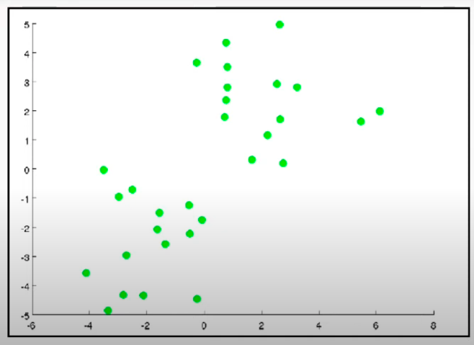

Slide 16
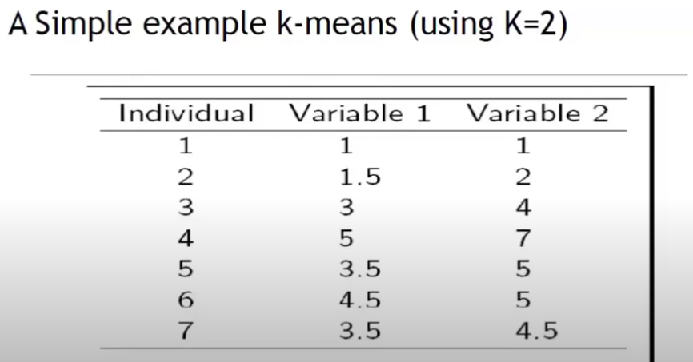

Slide 17
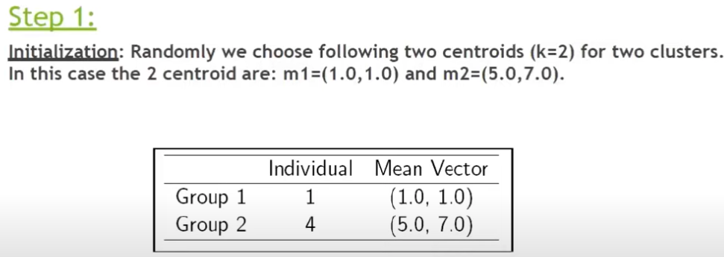

Slide 18
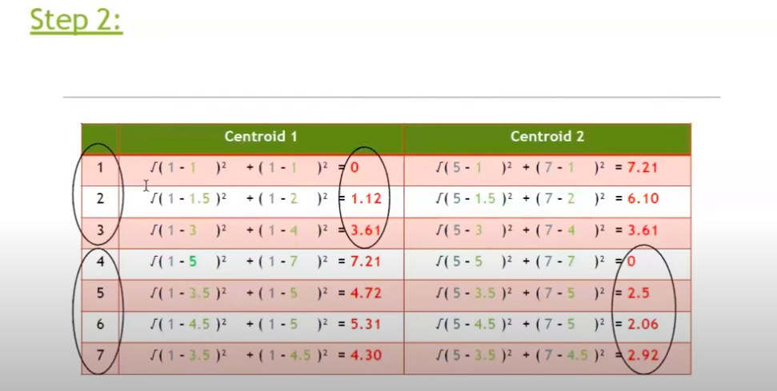

Slide 19
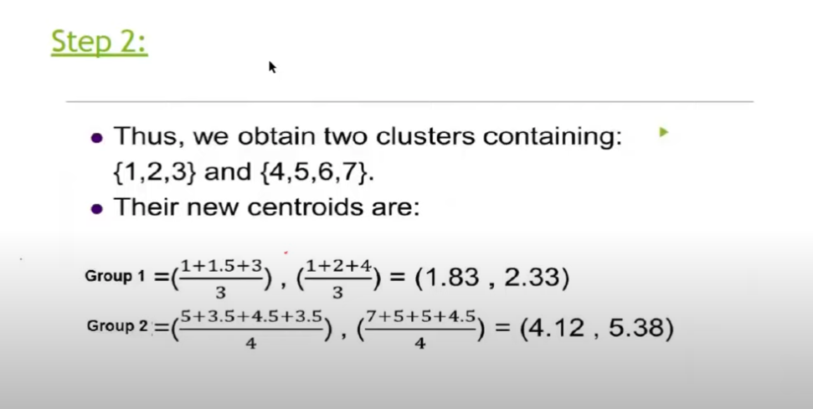

Slide 20
Density-based clustering
Density-Based Clustering refers to unsupervised machine learning methods that identify distinctive clusters in the data, based on the idea that a cluster/group in a data space is a contiguous region of high point density, separated from other clusters by sparse regions.

Slide 21
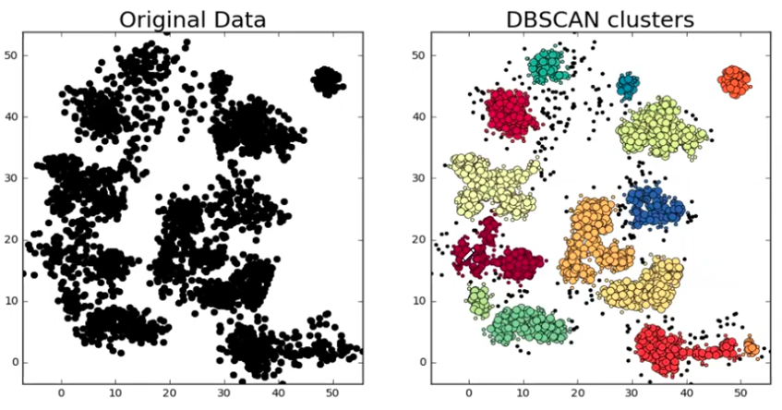

Slide 22
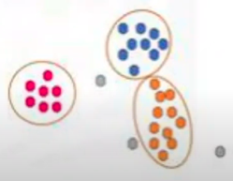

Slide 23
eps: It defines the neighborhood around a data point i.e. if the distance between two points is lower or equal to ‘eps’ then they are considered neighbors. If the eps value is chosen too small then a large part of the data will be considered as an outlier.
MinPts: Minimum number of neighbors (data points) within eps radius.

Slide 24
In this algorithm, we have 3 types of data points.
Core Point: A point is a core point if it has more than MinPts points within eps.
Border Point: A point which has fewer than MinPts within eps but it is in the neighborhood of a core point.
Noise or outlier: A point which is not a core point or border point.

Slide 25
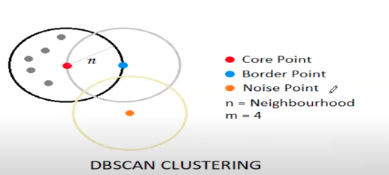

Slide 26
Distribution-based clustering
Distribution-based clustering involves probability-based clustering of data points. In this method, data is usually composed of distributions such as Binomial, Gaussian etc., and the data is fitted on the likelihood of it belonging to the same probability distribution.

Slide 27
Gaussian Mixture Model (GMM)
The cluster obtained from distribution-based methods contains those data points which have a higher probability of being in that specific cluster. This process focuses on the center of the distribution, as if the distance of a data point from the center is higher, lesser the probability of it being included in the cluster, and vice-versa.

Slide 28
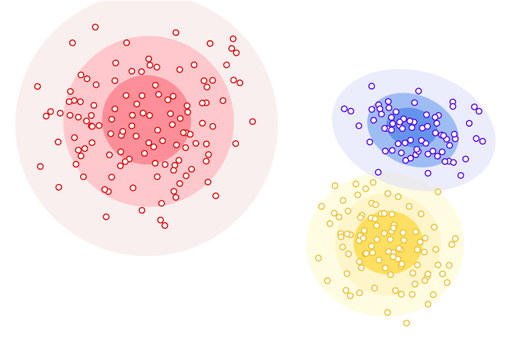

Slide 29
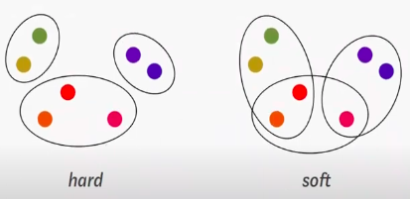

Slide 30
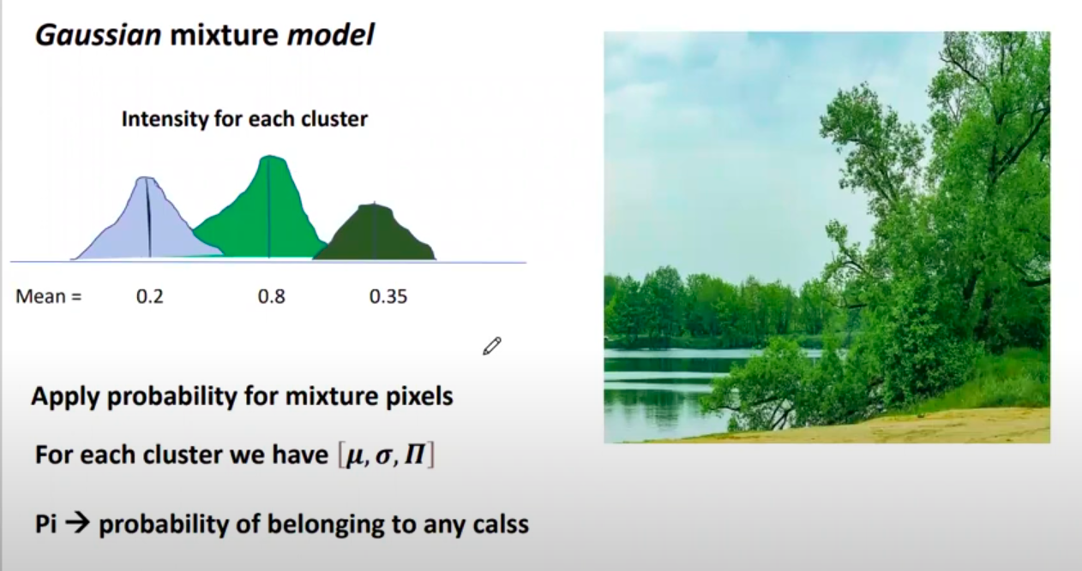

Slide 31
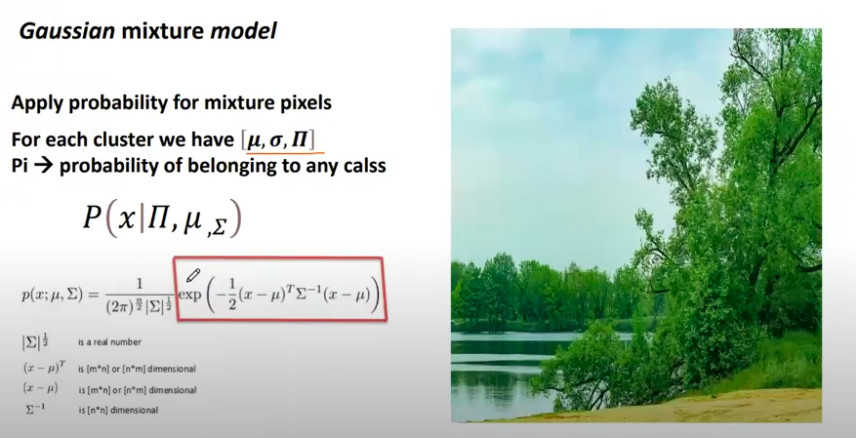

Slide 32
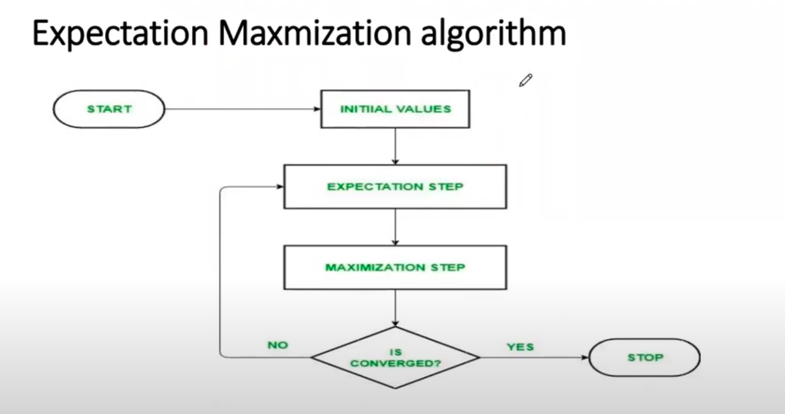

Slide 33
Hierarchical clustering
Hierarchical clustering is a connectivity-based clustering model that groups the data points together that are close to each other based on the measure of similarity or distance. The assumption is that data points that are close to each other are more similar or related than data points that are farther apart.

Slide 34
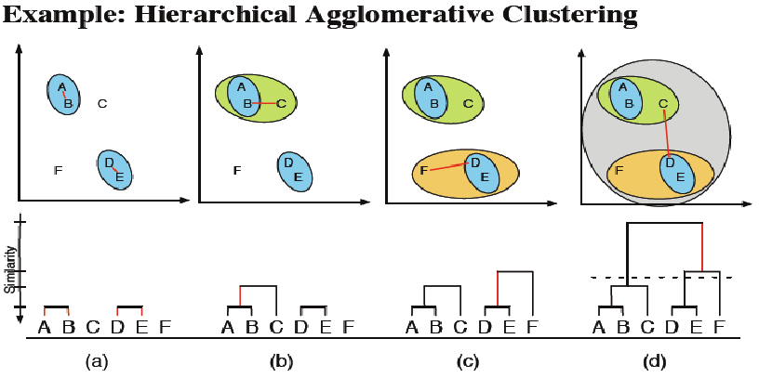

Slide 36
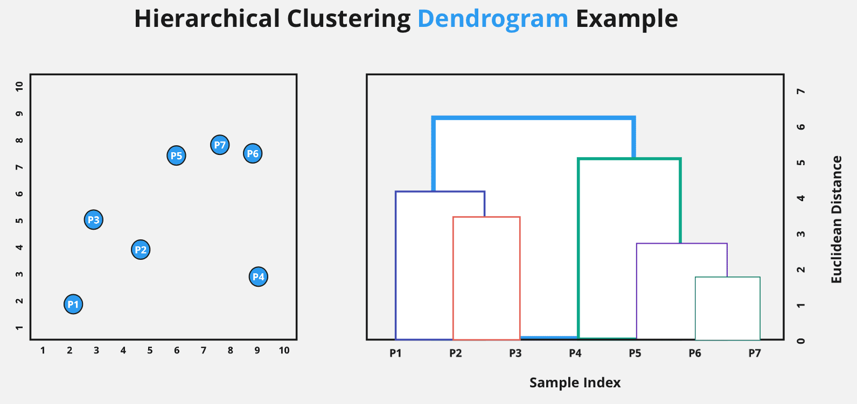

Slide 37
Types of Hierarchical Clustering
Basically, there are two types of hierarchical Clustering:
Agglomerative Clustering
Divisive clustering

